Slide 1
Common Properties
Color Property | Background Properties | Float and Clear Properties | Display Property | CSS Variables
Notes:
Welcome to out lecture on common properties of CSS. In this lecture we will go through common properties like Color Property, Background Properties, Float and Clear Properties, Display Property, and CSS Variables. Let’s start our lecture.

Slide 2
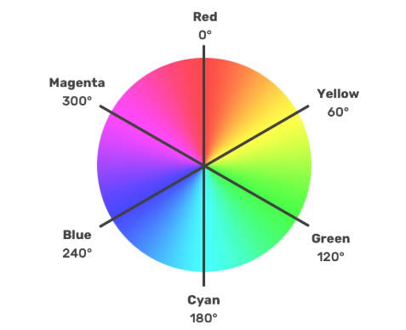
Color Properties
The color CSS property changes text color and supports 140 predefined color names (e.g., white, blue, black).
RGB values define colors using rgb(red, green, blue), with intensities ranging from 0 (lowest) to 255 (highest).
Examples: rgb(0, 0, 0) = black, rgb(0, 0, 255) = blue, rgb(255, 255, 255) = white.
Notes:
The color property in CSS controls the text color. CSS includes 140 predefined color names like white, blue, and black. Colors can also be specified using RGB values, which define intensities for red, green, and blue, ranging from 0 to 255. For example, rgb 0, 0, 0 is black, rgb 0, 0, 255 is blue, and rgb 255, 255, 255 is white. RGB makes color customization flexible and precise.

Slide 3
Color Properties
Hexadecimal (#RRGGBB): Defines colors with red, green, and blue intensities (00–FF). Examples: #000000 = black, #FFFFFF = white.
HSL (hue, saturation, lightness): Specifies colors using hue (0–360°), saturation, and lightness (0%–100%). Examples: hsl(0, 0%, 0%) = black.
RGBA/HSLA: Extend RGB/HSL with an alpha (transparency) value (0 = fully transparent, 1 = fully opaque). Example: rgba(255, 0, 0, 0.5) = half-transparent red.
Notes:
CSS supports multiple ways to define colors. Hexadecimal uses the format #RRGGBB with values from 00 to FF for red, green, and blue, such as #000000 for black. Hue saturation lightness uses hue 0 to 360 degrees, saturation, and lightness in percentages, like HSL 0, 0, 0 for black. RGBA and HSLA add transparency with an alpha value from 0 to 1, such as RGBA 255, 0, 0, 0.5 for half transparent red.

Slide 4
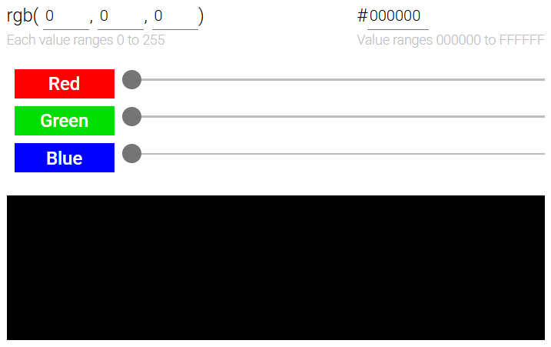
Example
Notes:
This example demonstrates RGB and Hexadecimal color selection. The RGB sliders adjust the intensity of red, green, and blue values, each ranging from 0 to 255. The combined RGB values display the resulting color in the box below. The corresponding hexadecimal color code is displayed alongside, such as rgb 0, 0, 0 matching #000000 for black. This tool highlights the relationship between RGB and Hex values.

Slide 5
Background Properties
Every element in a webpage has a set of background properties. Common background properties include:
The background-color property specifies the background color.
The background-image property specifies a background image.
The background property is shorthand for setting several of the element's background properties at the same time.
Notes:
Move on to background properties that control the appearance behind an element's content. The background color property sets the color, while the background image property specifies an image as the background. The background property acts as shorthand, allowing you to combine multiple background settings, like color, image, position, and size, in one declaration. These properties enhance design flexibility and customization.

Slide 6
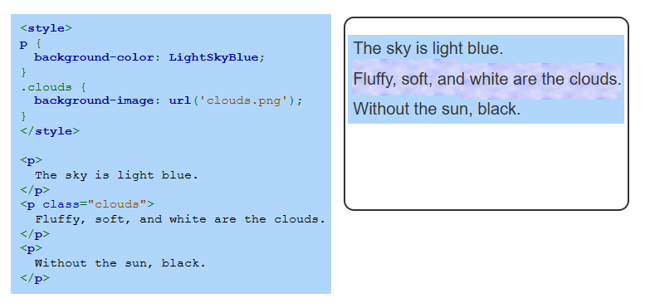
Example
Notes:
This example demonstrates the use of background properties. The paragraph elements have a light sky blue background set by the background color property. The class clouds applies a background image using the background image property, displaying a cloud pattern. These properties help style specific elements with colors and images, creating visually appealing designs tailored to the content.

Slide 7
Float Property
The float property determines if an element floats within its parent container.
none: Default; element does not float.
left: Element floats to the left side of the parent container.
right: Element floats to the right side of the parent container.
Notes:
Now we will explore the float property that controls how an element is positioned within its parent container. The default value is none, meaning the element does not float. Setting float to left makes the element float to the left side, allowing content to wrap around it. Similarly, float right positions the element on the right side. Float is commonly used for layouts and aligning content in flexible designs.

Slide 8
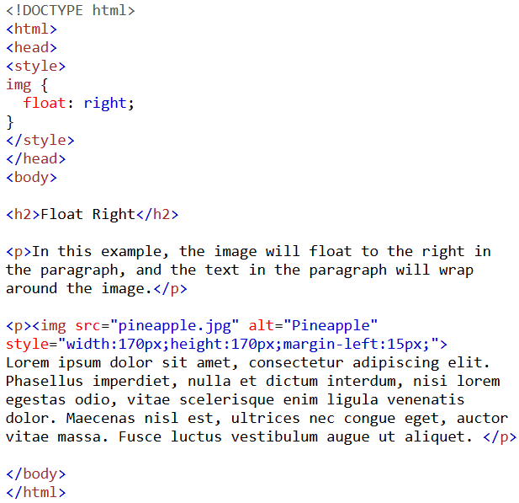
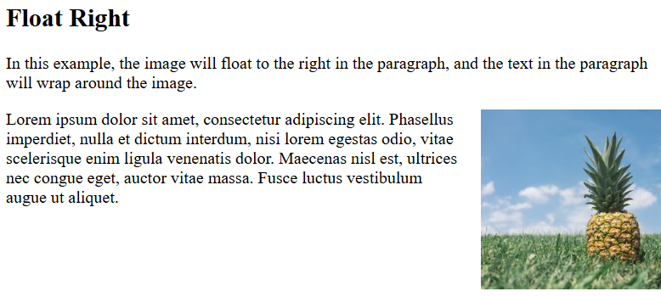
Example
Notes:
This example shows how the float property works. The image is styled with float right, which aligns it to the right side of the container. The paragraph text wraps around the image, creating a visually appealing layout. Float is commonly used for aligning elements like images or text within a webpage, allowing for dynamic and flexible content positioning in designs.

Slide 9
Clear Property
The clear property moves elements below previously floated elements. Values for the clear property include:
none - Element allowed to float (default value)
left - Stop floating on parent container's left side
right - Stop floating on parent container's right side
both - Stop floating on both sides
Notes:
Next property is clear property that prevents elements from wrapping around floated elements. The default value none allows floating. Setting clear to left stops floating on the left side, while clear right stops floating on the right side. Using clear both stops floating on both sides. This property ensures proper element placement when working with float based layouts, maintaining clean and organized designs.

Slide 10
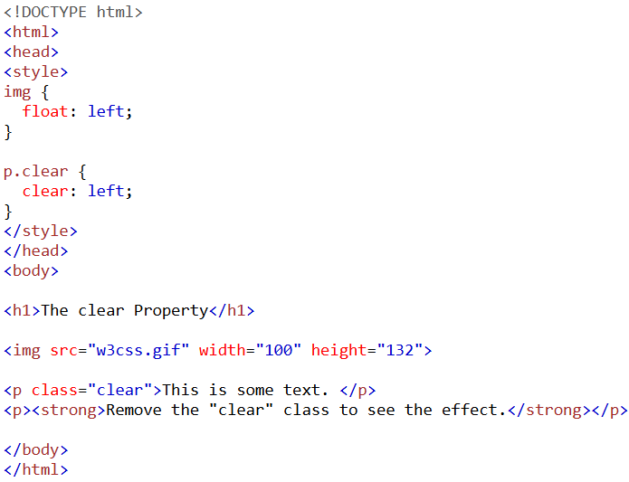
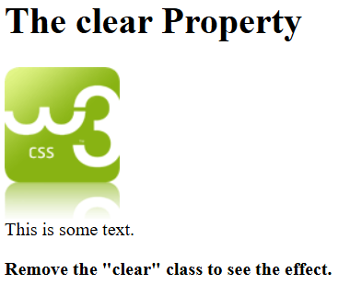
Example
Notes:
This example shows the clear property in action. The image is floated to the left using float left. The paragraph with the clear class uses clear left, ensuring it moves below the floated image. Without the clear property, the paragraph text would wrap around the image. The clear property is essential for maintaining layout consistency when working with floated elements.

Slide 11
Display Properties
The display property manages how an element is laid out on a web page. Display Properties include:
inline: Element behaves like span or a (inline element).
block: Element behaves like p, h1, or div (block element).
none: Hides the element from view (e.g., style elements).
Notes:
Now move on to the display property that controls how elements are rendered on a webpage. The inline value makes elements behave like span or a, aligning with surrounding text. The block value makes elements behave like p or div, taking up the full width. The none value hides the element completely, removing it from view. These settings are essential for structuring layouts and determining element visibility.

Slide 12
Display Properties
inline-block: Content acts like a block, but the element is inline.
list-item: Element is displayed as a list item.
Controls how elements interact with other elements visually.
Impacts both visibility and layout of elements.
Notes:
The display property further includes inline-block and list-item. Inline-block allows content to behave like a block but positions the element inline with others. The list item value displays elements as items in a list. Display properties define how elements interact visually and structurally, impacting their visibility and layout within the webpage for flexible design options.

Slide 13
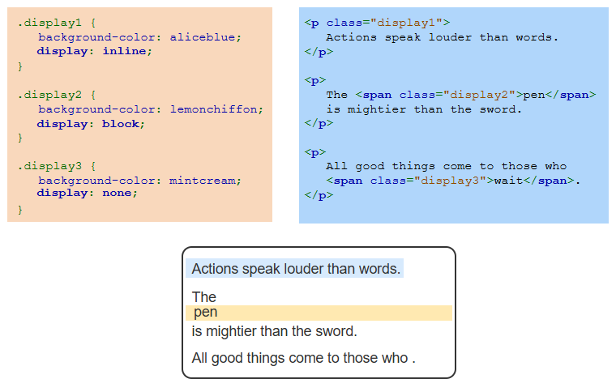
Example
Notes:
This example demonstrates different display values. The first class uses display inline, keeping the text inline. The second class uses display block, creating a new line for the element. The third class applies display none, hiding the element completely. These properties control how elements are rendered and are essential for structuring content and managing visibility in web designs.

Slide 14
CSS Variables
CSS variables simplify reusing values across stylesheets, reducing the need for manual updates.
Declared with two dashes (e.g., --my-variable: red;) and accessed using var(--my-variable).
Use :root for global scope, applying variables to the entire document.
Notes:
CSS variables make stylesheets more efficient by allowing reusable values, reducing manual updates. They are declared with two dashes, like hyphen hyphen my variable as red, and accessed using var keyword. To apply variables globally, use the colon root selector, which targets the entire document. CSS variables improve flexibility and maintainability in web design by centralizing commonly used values.

Slide 15
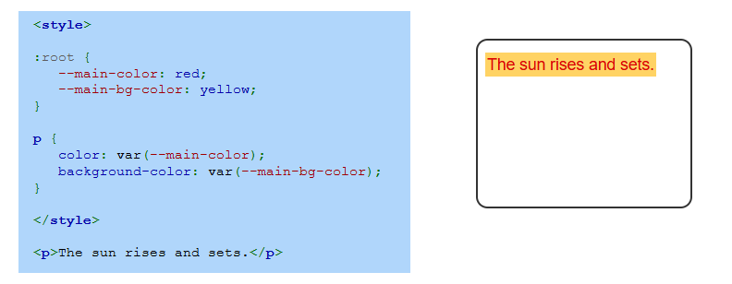
Example
Notes:
This example demonstrates CSS variables. In the colon root selector, hyphen hyphen main color is set to red and hyphen hyphen main BG color is set to yellow, making them global variables. The paragraph element applies these variables using the var function for text color and background color. CSS variables allow easy updates and consistent styling throughout the document by centralizing reusable values. Thanks for watching the lecture.

